Slide 1

2026 Service Plan
Local Urban District of Miami
Rural Municipality of Thompson
Date Adopted by LUD: March 18, 2026. Resolution: 2026-03-18
Date Presented to Council: Thursday, March 26 2026.
Date Adopted by Council: April 24, 2026 (Through Financial Plan Approval) Resolution: 2026-04-46 with changes

Slide 2
Agenda & Coverage
About the LUD of Miami
Purpose and Ask
Service Plan Highlights
Expenses
Revenues
L.U.D. of Miami Reserve Fund
Summary
Questions??

Slide 3
Welcome!
The Local Urban District (L.U.D.) of Miami, is pleased to present its 2026 Service Plan.
The L.U.D. Committee of Miami mission is to enhance the quality of life in our community through ensuring that municipal services are delivered at a level and in a manner that meets the expectations of its citizens. We believe that this is possible, by continuing to welcome suggestions and involvement from all areas of our community to ensure that we represent your interests and the interests of Miami as a whole.
It is our continued objective to improve the condition of infrastructure and image of our community, while maintaining a balance of ideal vision and tax burden to the ratepayers of Miami.

Slide 4
Introduction of the L.U.D. of Miami Committee Members
The Local Urban District Committee Members of Miami are as follows:
Judy Knox Chairperson
Barb Murray Member
Donna Cox R.M. of Thompson Council Representative
The LUD of Miami Committee acts by their Rules of Procedures and follows Council indemnities for mileage and reimbursement.

Slide 5
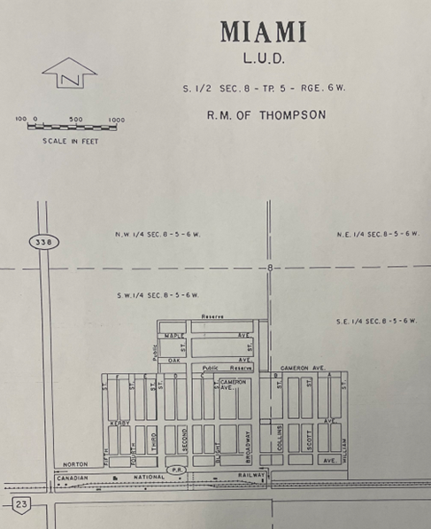
L.U.D. of Miami Boundary
= Existing
= New Development area

Slide 6
LUD Assessment & Population
Miami Total Property Assessment (portioned): $17,200,840
Miami Population: (2021 Census) 464

Slide 7
L.U.D. of Miami Assessment and Mill Rate History
Year | Assessment | Mill Rate
2018 | 9,679,700 | 7.170
2019 | 10,109,450 | 7.170
2020 | 11,835,420 | 7.470
2021 | 11,930,970 | 7.470
2022 | 12,201,210 | 7.694
2023 | 13,992,650 | 7.380
2024 | 14,085,530 | 7.519
2025 | 17,206,780 | 6.445
2026 | 17,200,840 | 7.430
What does this mean to my taxes?
In 2025 per $100,000 portioned assessment on residential would be $644.50
In 2026 per $100,000 portioned assessment on residential would be $743.50
Notes:
2024 Mill rate comparisons
Manitou 4.593
LaRiviere 10.627
Darlingford 13.601

Slide 8
Purpose & Ask
Purpose:
To detail the type, level and cost of municipal services to be provided within the LUD of Miami
Provide an overview of the 2026 Service Plan which forms part of the RM of Thompson’s Financial Plan
Ask:
Review and approve the LUD of Miami Service Plan as part of the RM of Thompson 2026 Budget

Slide 9
2026 Service Plan Highlights
Mill Rate: 7.430 (15.28% increase)
Revenue Required from Taxation: $127,800.00
Transfers to Capital: $50,000.00 (lagoon, street)
Transfers to Reserve:
$10,000.00
Operational Expenses:
$181,100.00
Transfer from Reserve:
$50,000.00

Slide 10
2026 Operating Expenditures
GENERAL GOVERNMENT SERVICES
  Compensation: $7,800.00
  The L.U.D. of Miami committee members are paid $1,750 semi-annually, and the Councillor Representative is paid $25/hr to attend the committee meetings
  Municipal Office and Administration: $30,000.00
  The L.U.D. of Miami contribution to Municipal Office operating expenses and administration salaries
  TOTAL GENERAL GOVERNMENT SERVICES $37,800.00
  (Increase here of $14,050.00 based on portion of office administration for LUD)

Slide 11
2026 Operating Expenditures – Cont’d
TRANSPORTATION SERVICES
  Streets and Backlanes: $10,000.00
  Sidewalks and Boulevards: $1,000.00
  Street Cleaning: $3,000.00
  Hydrant Rentals: $2,100.00
  Street Lighting: $4,500.00
  Other Miscellaneous: $1,000.00
  TOTAL TRANSPORTATION SERVICES $21,600.00
Notes:
Streets decreased as we would like to concentrate on sidewalks and boulevards which is a large increase from last year. $30,000 of this $50,000 will be coming from LUD Reserve. Overall, there is an increase in transportation services.

Slide 12
2026 Operating Expenditures – Cont’d
ENVIRONMENTAL HEALTH SERVICES
  Garbage Collection: $5,000.00
  Recycling: $1,000.00
  Sewer Flushing: $5,000.00
  By-Law Enforcement Services: $1,500.00
  TOTAL ENVIRONMENTAL HEALTH SERVICES $12,500.00
Notes:
Garbage collection should be increased to account for MWM curbside increase not included in the levy. Overall, decrease slightly due to By-Law enforcement. Garbage collection is for trailer from town?

Slide 13
2026 Operating Expenditures – Cont’d
ENVIRONMENTAL DEVELOPMENT SERVICES
  Weed Control: $1,000.00
  Tree Removal: $5,000.00
  TOTAL ENVIRONMENTAL DEVELOPMENT SERVICES $6,000.00

Slide 14
2026 Operating Expenditures – Cont’d
RECREATION AND CULTURAL SERVICES
  South Central Regional Library (Miami Branch): $5,000.00
  Parks and Playgrounds: $8,200.00
    Maintenance, Flowers, Equipment, Campground, Playground
  Memory Gardens: $3,500.00
    Maintenance, Flowers, Equipment, Sign
  LUD Mowing: $13,000.00
    Contract
Notes:
May need to increase mowing. (Do not mention tenders received and amounts) Mowing last year was broken up to be Parks and Playground mowing $13,750 of “Rural Tender” and Memory Garden mowing half of LUD Tender. This year we would like just general LUD mowing to cover full LUD tender and for RM to pay full Rural Tender.

Slide 15
2026 Operating Expenditures – Cont’d
RECREATION AND CULTURAL SERVICES – CONT’D
  Pavilion: $500.00
  Cenotaph Grounds: $500.00
  Green Team Equipment and Supplies: (buggy and wages) $10,000.00
  Pergolas: $300.00
  Christmas Lights: $1,000.00
  Mailouts and Notices $100.00
  LUD Insurance: $1,100.00
  TOTAL RECREATION AND CULTURAL SERVICES: $43,200.00
Notes:
Pavilion increased due to sound panels and stain, cenotaph decreased, green team increased to include lease of side by side machine. Pergolas decreased since stained last year. Christmas lights increased to provide street light displays hopefully. Showcase event decreased, should not be at a cost other than rental of MALC but grant dependent for bouncy castles. Overall, rec and culture down significantly from last year.

Slide 16
2026 Operating Expenditures – Cont’d
TRANSFERS
    Transfer to Capital (lagoon, streets): $50,000.00
      lagoon expansion
        Environment Act Proposal, Design, Geotechnical and survey
        Cost shared with MB Water Services Board
    Transfer to LUD reserve: $10,000.00
    Transfer from LUD reserve: $50,000.00

Slide 17
2026 Revenue from Taxation
Portioned Assessments L.U.D. of Miami 2026: $17,200,840.00
Revenue Sources:
  L.U.D. of Miami Reserve Funds: $50,000.00
  Short Term Interest: $2,500.00
  Memory Garden Donations and Campground Revenue $800.00
  Tax Levy: (7.430 mills) $127,800.00
  Total Operating Revenues: $181,100.00

Slide 18
2026 Capital/Project Expenditures
Lagoon Expansion: $35,000.00
Streets: (Norton Avenue portion not covered by MTI) $15,000.00
TOTAL CAPITAL /PROJECT EXPENDITURES $50,000.00
Notes:
Last year was sidewalks, streets and drainage study totaling $50,000 from reserve, this year will be $30,000 from reserve. Lagoon transfer to of $5,000 is not included as it is for future.

Slide 19
L.U.D. of Miami Reserve Funds
LUD RESERVE FUNDS: $133,356.70
2026 LUD RESERVE FUND ACTIVITY:
  CAPITAL/PROJECT EXPENDITURES:
    FUTURE LAGOON EXPANSION (from reserve): $35,000.00
    STREET RENEWAL $15,000.00
    TRANSFER TO RESERVE: $10,000.00
    2026 ENDING BALANCE OF RESERVE FUNDS: $93,356.70

Slide 20

Questions??

Slide 21
Thank you!
Your elected L.U.D. of Miami Committee look forward to serving our community with a continued focus to achieve a higher level of prosperity and community unification. We remain open and receptive to community enhancing ideas from the residents of Miami.
Respectfully submitted by the L.U.D. of Miami Committee
Judy Knox Barbara Murray Donna Cox
Chairperson Member Council Rep

